Slide 1
In Vehicle Networking Project
Fleet Tracking and Monitoring System
Team ProtoCAN
Review 2
Presented By:
Abishek R – 22MES0011
Ashwin Hariharan R – 22MES0025
Aadhitya S V – 22MES0007
Ezhil Subbia K – 22MES0006
Kevin Abishek S – 22MES0041

Slide 2
Features Executed
Uses GPS tracking to monitor the activity of fleet vehicles and assets.
Reliable and scalable data collection for vehicle trackers and embedded sensors.
Advanced and flexible IoT data visualization for both real-time and historical vehicle data.
Customizable end-user dashboards to share data from the vehicle tracking system with end users and customers
Driver driving patterns monitoring – sudden acceleration, deceleration, braking, etc.
Monitoring of critical payload environment – temperature, pressure, humidity, etc

Slide 3
Warning Mechanism Used
The owner has the access to both the dashboard and the app, while the driver has the access to the app which can be installed onto to the vehicle’s existing infotainment system.
Various warnings have been displayed in the app which includes temperature, pressure, humidity, Vehicle roll over, sudden acceleration, sudden breaking, EMF warning.
For example, when temperature crosses above the threshold an immediate mail and In-App notification would be sent to the owner as well as an alert sound would be turned on and alerts the driver. Similarly, when any parameters varies over the desired limit the appropriate warning would be raised through the alert sound, an email notification and through the indicator in mobile dashboard.

Slide 4
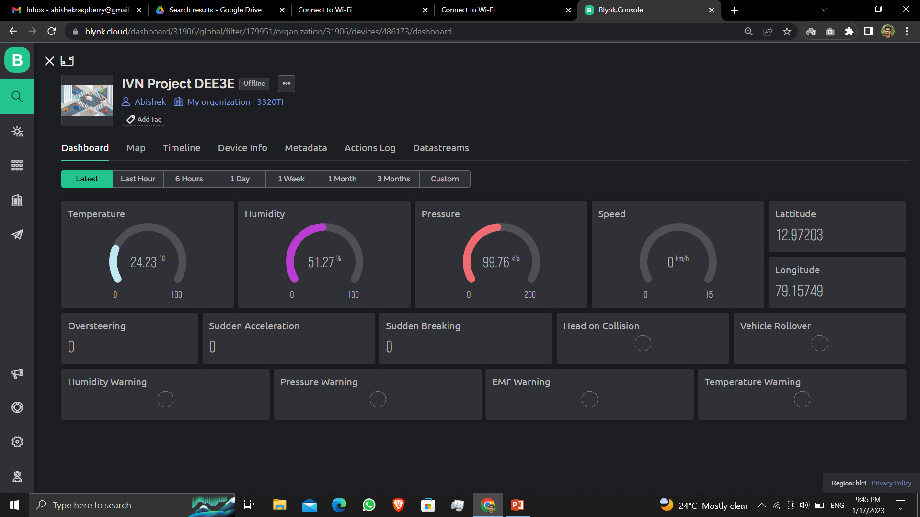
Dashboard

Slide 5
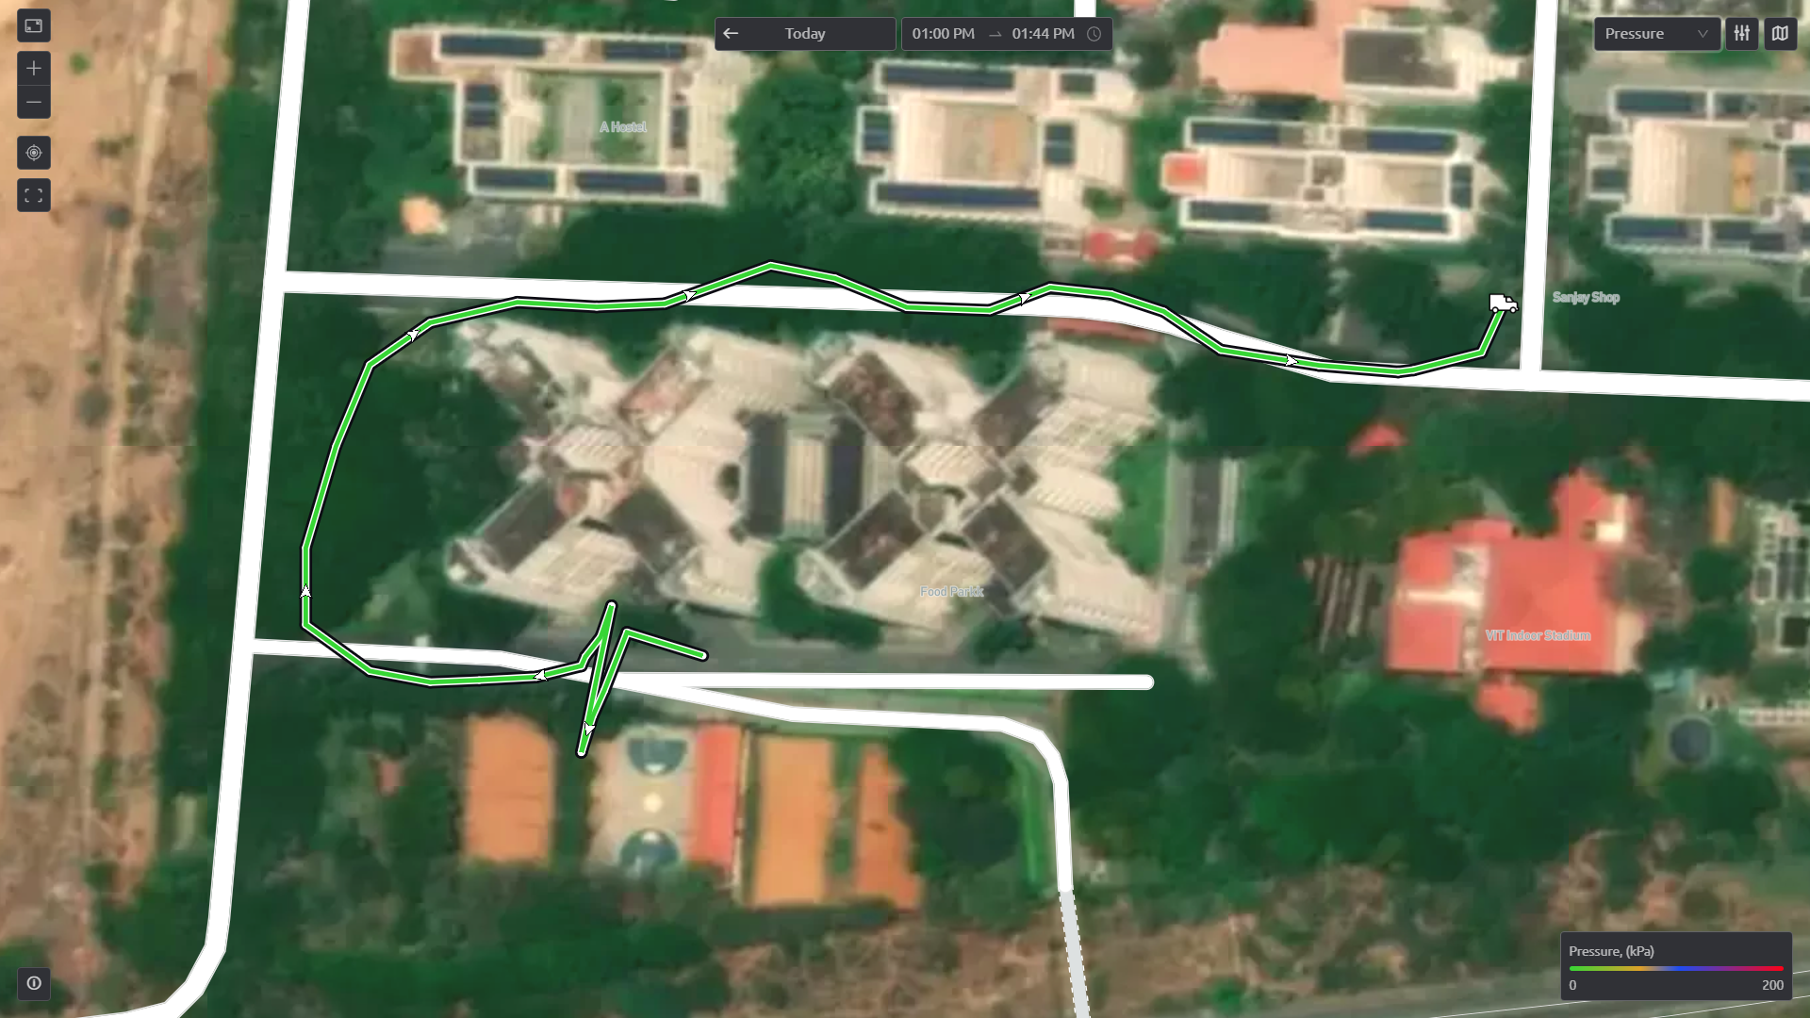
Dashboard

Slide 6
CAN Nodes
Node 1
AVR microcontroller
UBLOX NEO 6M GPS
Bi-directional Logic Level Shifter
MCP2515 CAN Controller
CAN H
CAN L
Node 2
ARM microcontroller
LSM9DS1 IMU – 3 axis(accelerometer, gyroscope and magnetometer)
LPS22HB Barometric Sensor
HTS221 Temperature and Humidity Sensor
MCP2515 CAN Controller
CAN H
CAN L
Node 3
Node 3
XTENSA microcontroller
Wi-Fi
Backend Server/ Data Backup
SN65HVD230 CAN Transceiver
LM2596 DC-DC Buck Converter

Slide 7
Components Justification
Microcontrollers:
Arduino Nano - ATmega 328P (used in Node 1):
8-bit 16MHz processor
Least powerful processor of all nodes
Only used to forward GPS data through CAN bus (GPS has it’s own ARM processor for running algorithms)
5V logic
No inbuilt CAN controller
2) Arduino nano 33 BLE sense – UBLOX ARM Cortex M4 (used in Node 2):
32-bit 64MHz processor
Second power processor of all nodes
Embedded with IMU, temperature, humidity, pressure sensors
All algorithms for calculating sensor readings and driving patterns are done on edge.
3.3V logic
No inbuilt CAN controller
3) NodeMCU ESP32 - Tensilica Xtensa LX6 (used in Node 3):
32-bit 240 MHz dual core processor
Most powerful processor of all nodes
Collects data from all nodes and forwards it to dashboard via secured HTTPS API
Secondary data storage via SPIFFS
Inbuilt NXP SJA1000 CAN controller

Slide 8
Components Justification
Sensors:
4) LSM9DS1, LPS22HB, HTS221:
Industrial grade sensors from STMicroelectronics
Supports both SPI and I2C
Uses I2C in Arduino nano 33 BLE sense board
Factory calibrated
Temperature compensated
CAN Controller:
5) MCP2515:
Standalone CAN controller with SPI interface
AEC-Q100 qualified chip
Automotive grade manufactured by MicroChip
CAN 2.0B
CAN Transceiver:
6) TJA1050:
High speed CAN transceiver with 1Mbaud speed
Compatible with the ISO 11898 standard
Manufactured by NXP

Slide 9
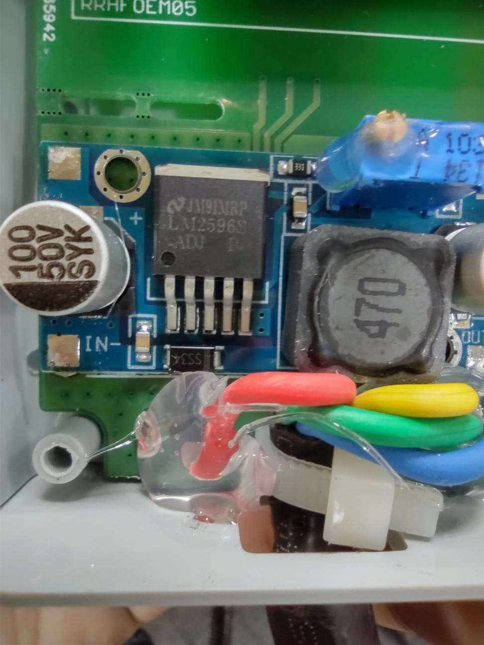
Components Justification
6) SN65HVD230:
High speed CAN transceiver with 1Mbaud speed
Compatible with the ISO 11898 standard
Manufactured by TI
Compatible with 3.3V logic
GPS:
7) UBLOX NEO 6-M:
Standalone GPS with inbuilt compute engine
Cold start
UART
AEC-Q100 qualified chip
ISO 16750 Certified (Road vehicles - Environmental conditions and testing for electrical and electronic equipment)
Power:
8) LM2596:
Step down 150 KHz synchronous DC-DC buck converter from TI
4.5V to 40V
3A
Can withstand constant voltage fluctuations

Slide 10
Block diagram for CAN communication
Node 1 Node 2 Node 3
Microcontroller
SPI Master
Microcontroller
SPI Master
500 Kbits/sec
MISO
CLK
SS
MISO
CLK
500 Kbits/sec
MOSI
MOSI
SS
CAN
Controller
CAN
Controller
Microcontroller with CAN controller
SPI Slave
SPI Slave
CAN TX
CAN bus to TTL
CAN bus to TTL
CAN TX
CAN RX
CAN Transceiver
CAN_H Bus
CAN_H Bus
CAN Transceiver
CAN Transceiver
CAN_L Bus
CAN_L Bus

Slide 11
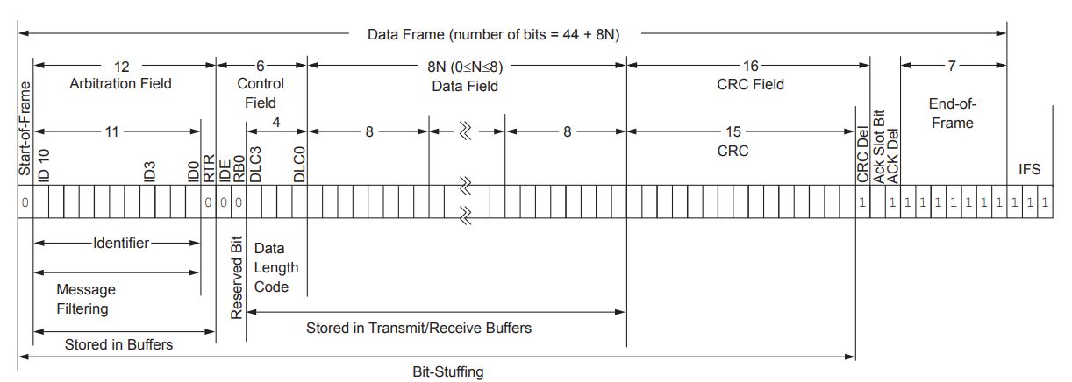
Why CAN 2.0B with 11 bit identifier
With CAN 2.0B specification both 11 bit and the extended 29 bit identifier can be used.
With a 11-bit identifier, it is possible to generate 2048 unique CAN frames, which is more than sufficient for this project.
Additionally, using a 11-bit identifier also decreases the bandwidth usage of CAN bus. (7 frames)

Slide 12
Bandwidth Usage
Node 1:
3 CAN frames – 301 bits/sec (8,8,4)
Node 2:
4 CAN frames – 412 bits/sec (8,8,8,4)
CAN bus speed set – 500 kbps
Total Bandwidth usage – 713 bits/sec
Total bandwidth utilization – 0.13%
Rest of the bandwidth will be used by other vehicular communication

Slide 13

Microcontroller Architecture Issues
Microcontroller INT datatype handling:
AVR – 2 bytes
ARM – 4 bytes
XTENSA – 3 bytes (signed int by default)
CAN controller can transmit data but the receiver cannot understand the data due to size difference
Microcontroller CHAR datatype handling:
AVR – 1 byte
ARM – 1 byte
XTENSA – 1 byte
Data is transferred via character array

Slide 14
CAN Frame Priority
By default latitude and longitude data has the highest priority.
If any one of the warning conditions is achieved, the CAN identifier is swapped giving the warning data highest priority temporarily.
The identifier is swapped back to original after the warnings subsides.

Slide 15
Thank You

